Slide 1

L4/5 GROUP 13
Amy Potter
Sean Turner
Alex Mednick
Alex Turnbull
Notes:
ALPHA PITCH
Where your game is currently
Iterations as a result of feedback
Usability testing

Slide 2
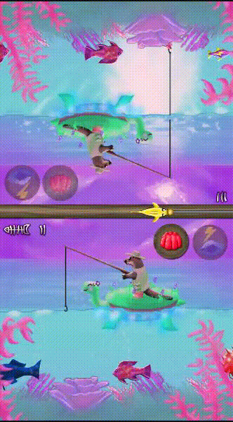
The Game
Adversarial
Turn-Based
Symmetrical
Players tap once, their opponent’s turn begins instantly
AP
Notes:
Our game is an adversarial, turn-based symmetrical game where players tap once to reel in a fishing line, instantly starting their opponent’s turn. Fish move at all times on both sides, so players make decisions about the best time to catch or avoid certain fish.

Slide 3
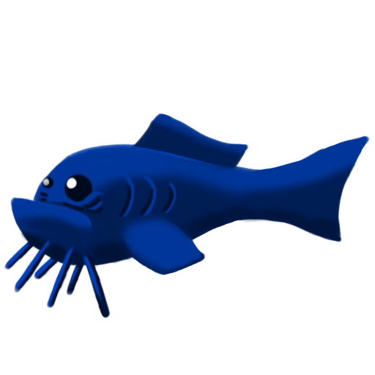


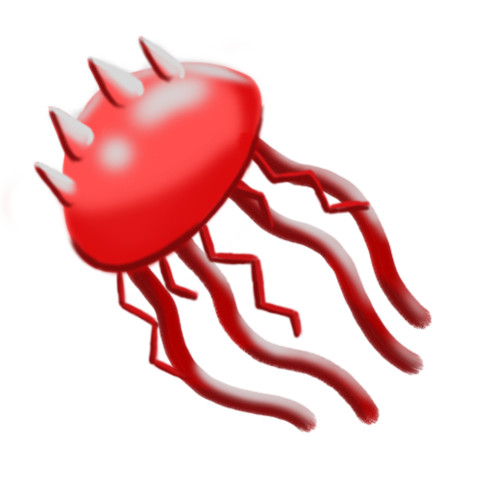
Delivering Fun Emotions
Tactical with a small element of twitch.
Rubber-banding creates close games.
Close wins create fiero.
People fun
Schadenfreude
ST
Notes:
The game is mostly a tactical competition, players make decisions of which fish to catch and when. The twitch element of timing keeps gameplay exciting, and the random fish spawning makes the game fun for all skill levels.
Rubber-banding is used to keep gameplay close so that neither player knows who will win until the end. Jellyfish, which deduct score, are more likely to appear for a player in the lead.
One key way we create schadenfreude is shown by diagram. Use jelly powerup, opponent hits jellyfish, they are punished. Other ways to directly affect their gameplay such as denying them a chance to catch a big fish or desirable powerup.

Slide 4

Playtest video

Slide 5
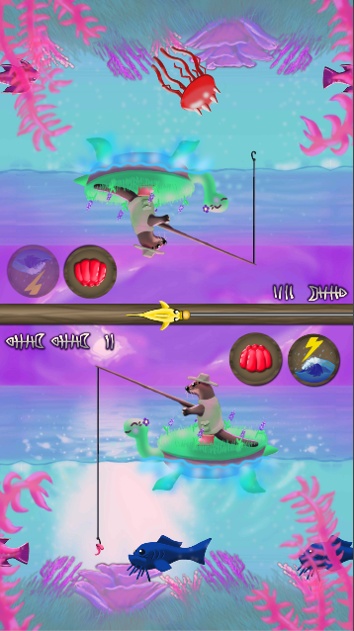
The Beta Build
All gameplay mechanics
Full menu system
All Core art assets implemented
AT
Notes:
Our beta build is fully functioning with all gameplay and art assets.

Slide 6
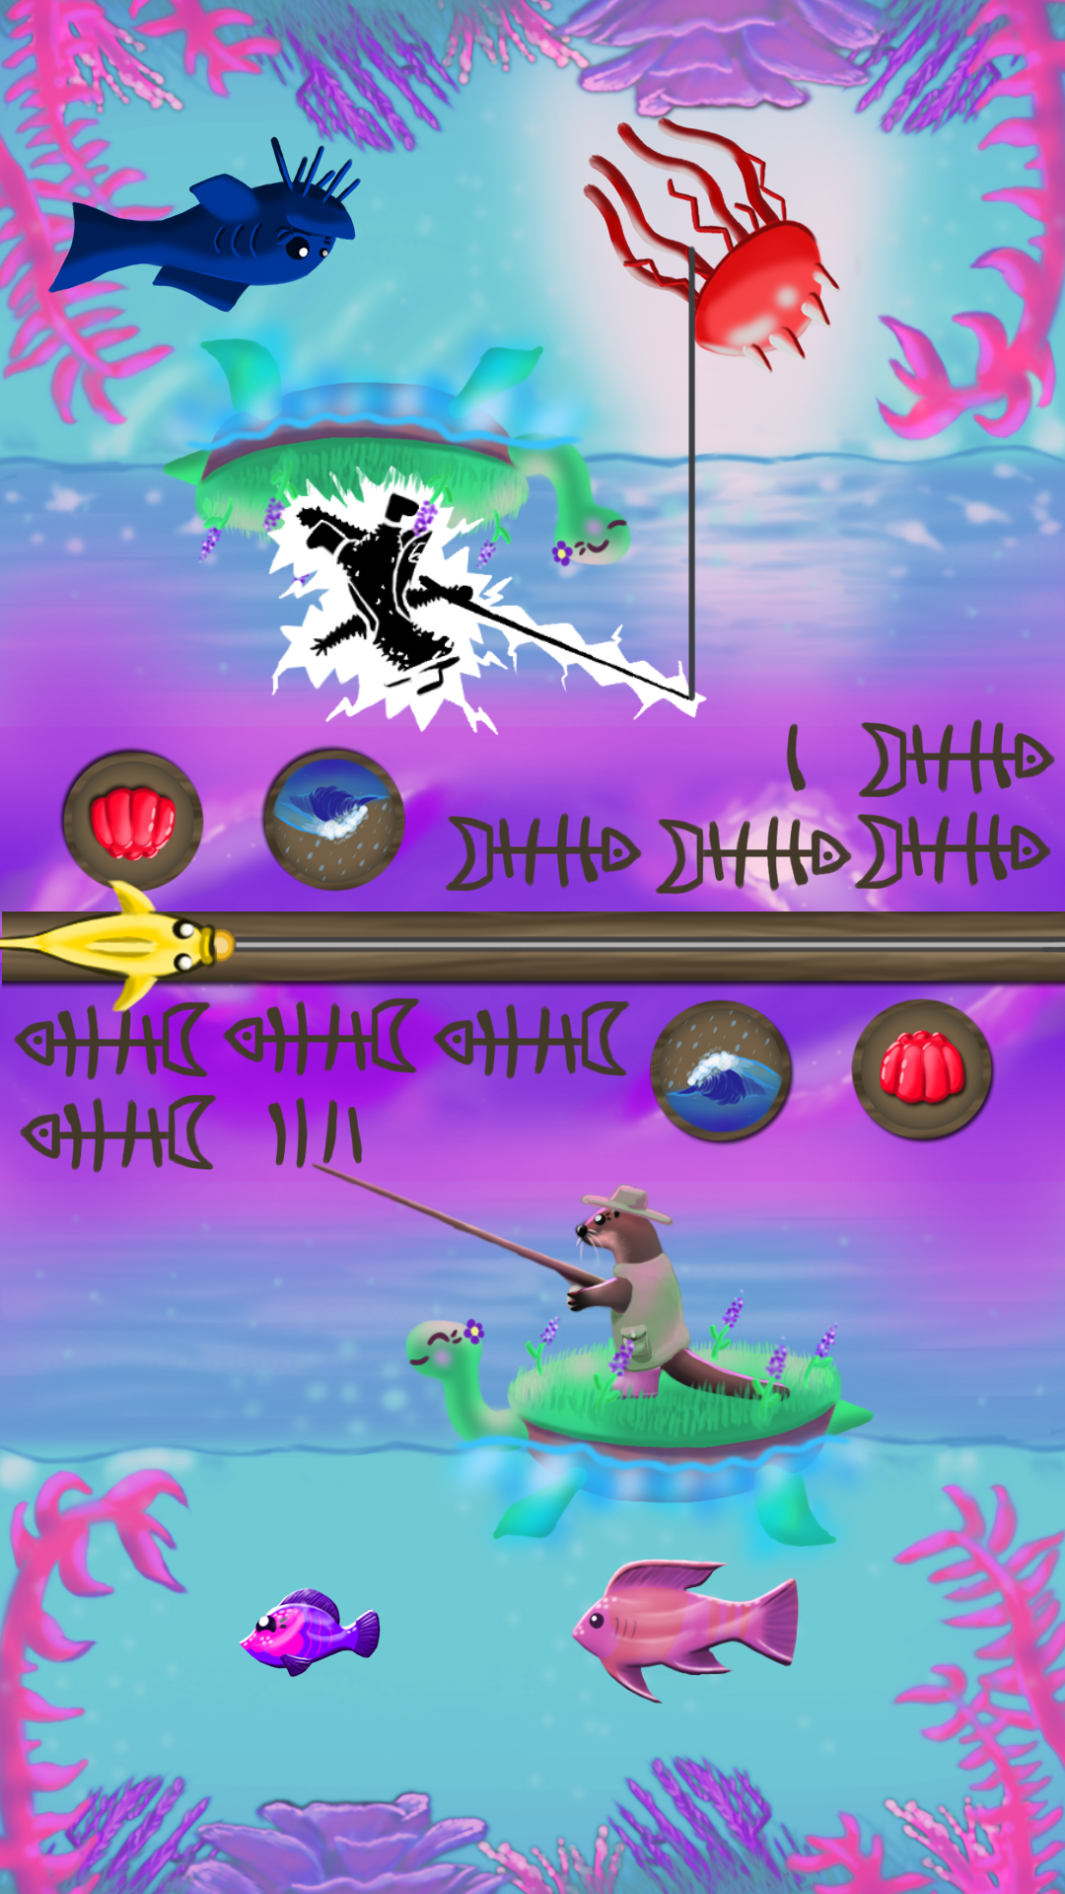
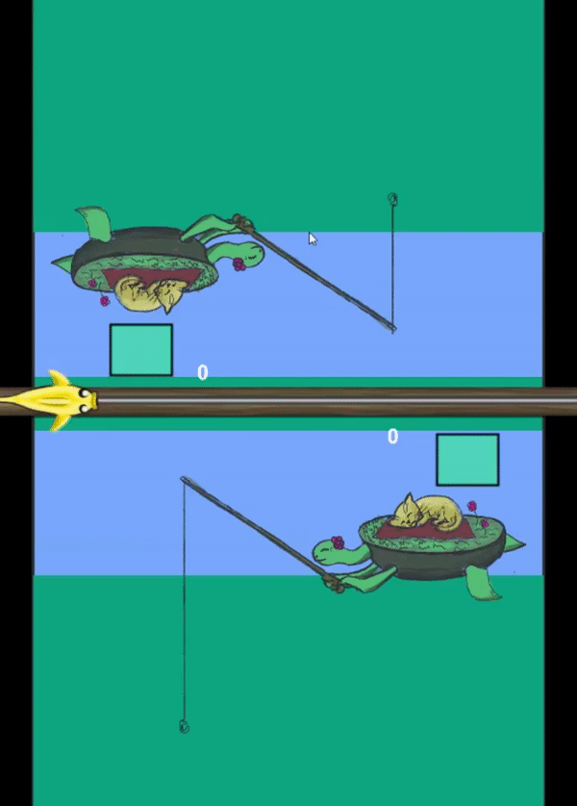
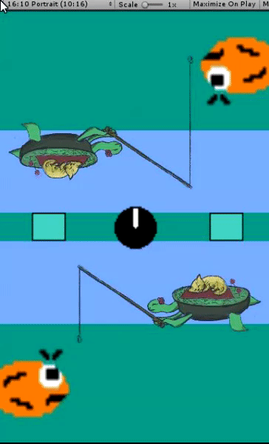
Iterations
(Based on tutor and playtesting feedback)
More visual feedback and affordances
Changes to visual hierarchy
Changes to menu system
ST

Slide 7

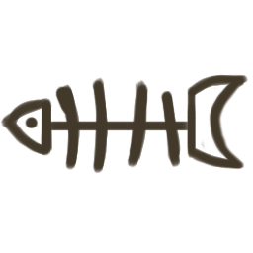
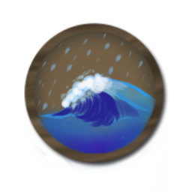
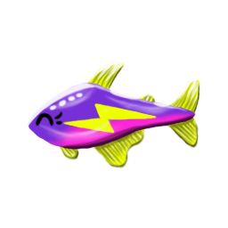

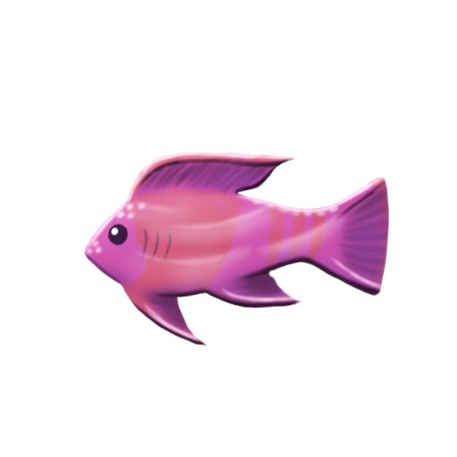
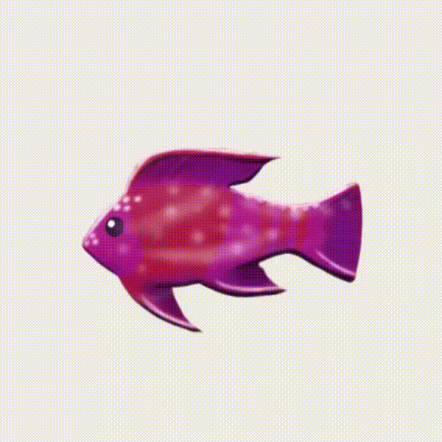
Visual Hierarchy
With two screens for players to keep an eye on, clarity is important
Improved interface clarity
Fish stand out more
ST
Notes:
With two screens for players to keep track of, visual hierarchy is a key design challenge.
Iterations to the UI has made it clearer, such as making the score tallies higher contrast and adding bright yellow to the speed powerup button. The lightning also gives a better affordance of speed, as well as linking it to the relevant fish.
Iterations to the fish make them stand out more, being darker, more saturated, and also animated to pop out more from the background.

Slide 8
Visual Feedback
Jellyfish zaps now have strong animated feedback.
Accompanied by phone vibration haptic feedback.
Looking to develop feedback further e.g. particles.
ST
Notes:
The jellyfish zapping feedback jumps to the top of the visual hierarchy for half a second with the black and white flashing contrast, so it is very clear to players when they have been punished.
The addition of haptic feedback makes this effect more surprising on mobile.
Jellyfish zaps often create reactions in playtesting, players shouting “oh no” or laughing at their opponent.

Slide 9
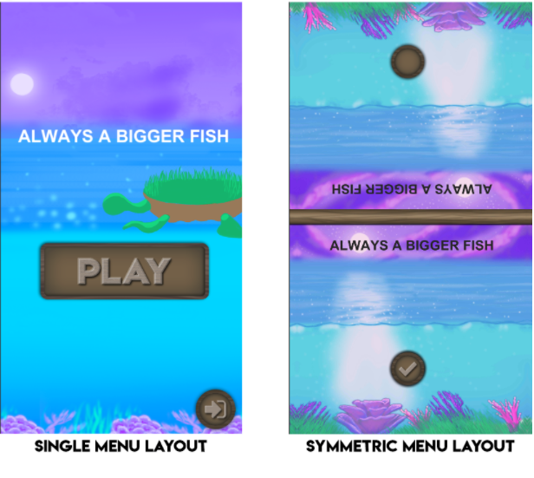
Menu System
AP
Notes:
1

Slide 10
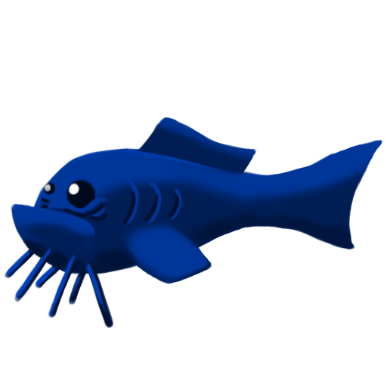
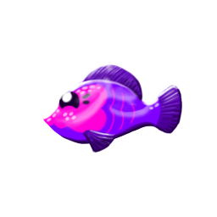
Balancing
Fish movement speed has been reduced
Score awarded by different fish sizes tweaked
QQ
Notes:
Speed reduced so that twitch skill is less important, better for audience and the brief.
Scores are now 1 for small, 2 for medium and 4 for big instead of 1/3/5, big fish are now more desirable than before making play more competitive for them.

Slide 11
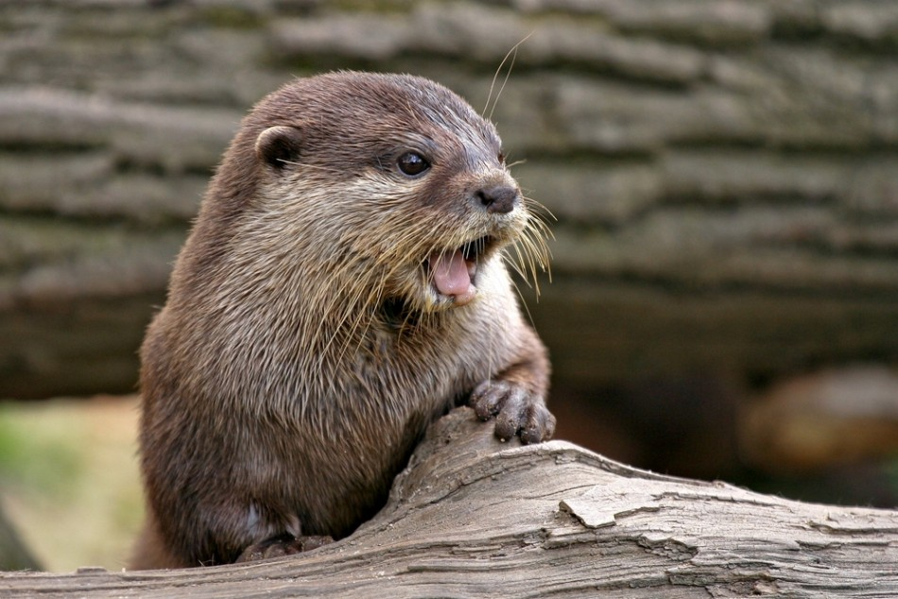
Notes:
Alex M - To have on slide as background when talking about sound

Slide 12
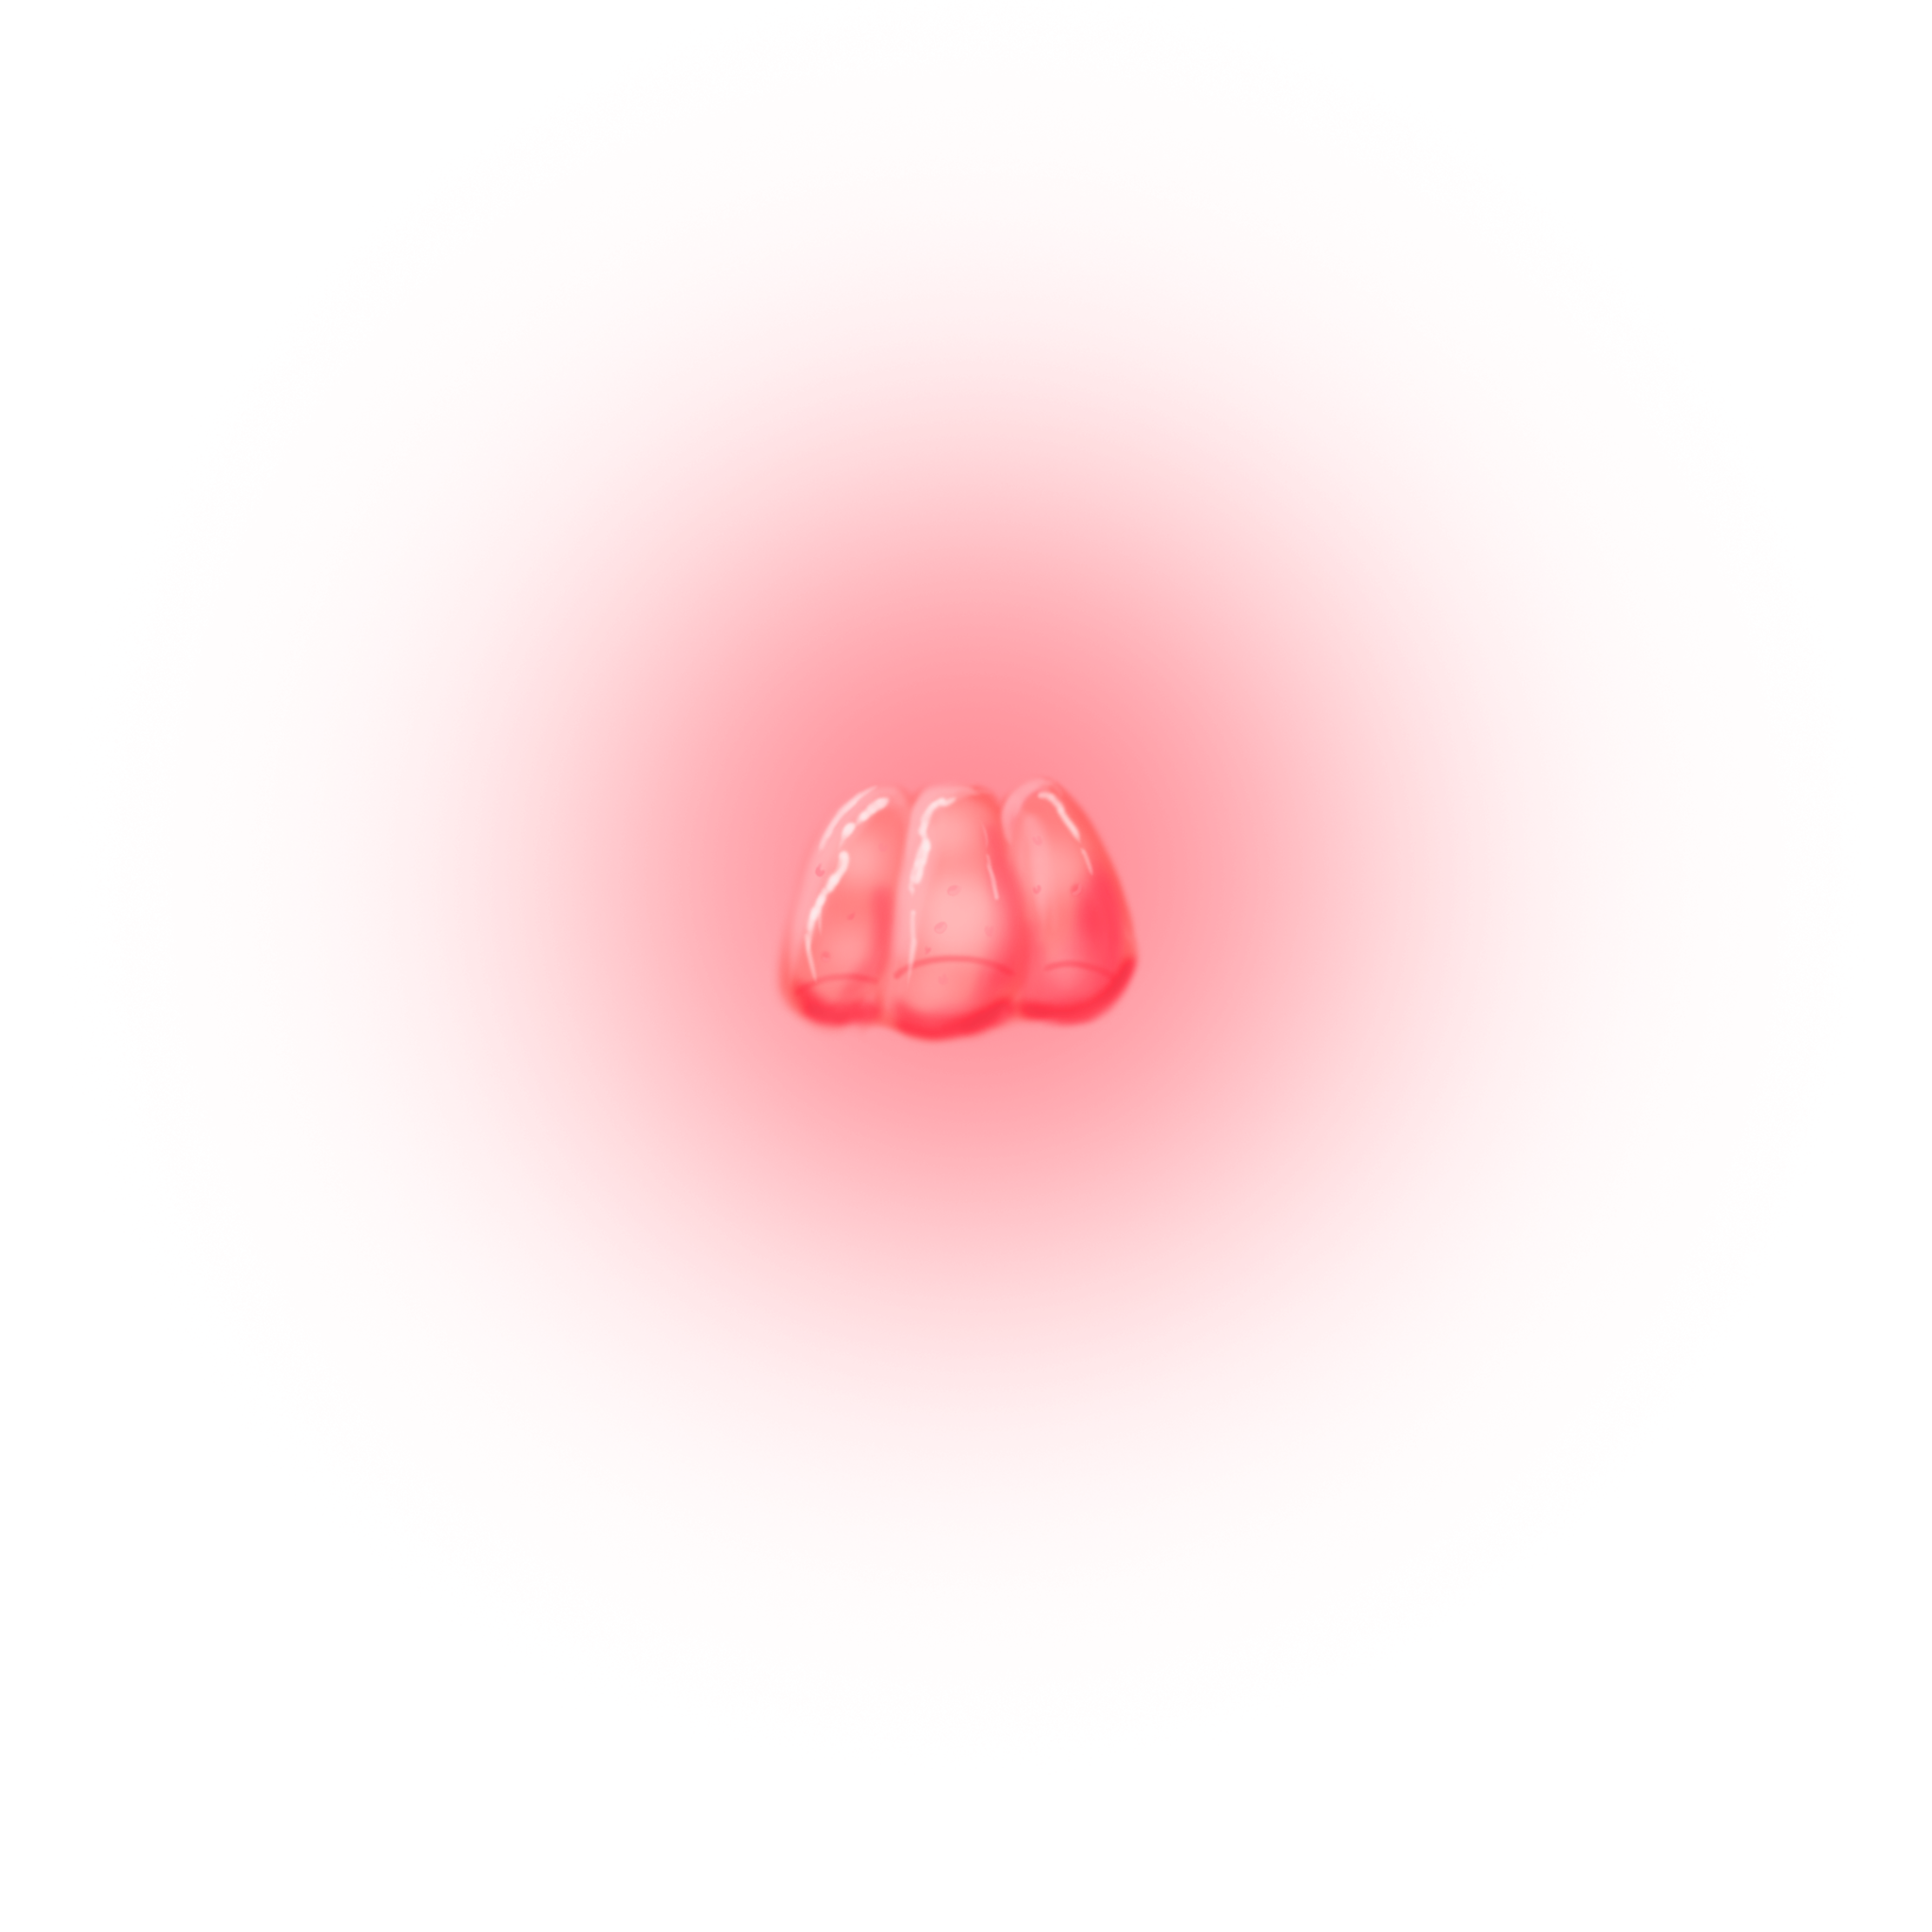
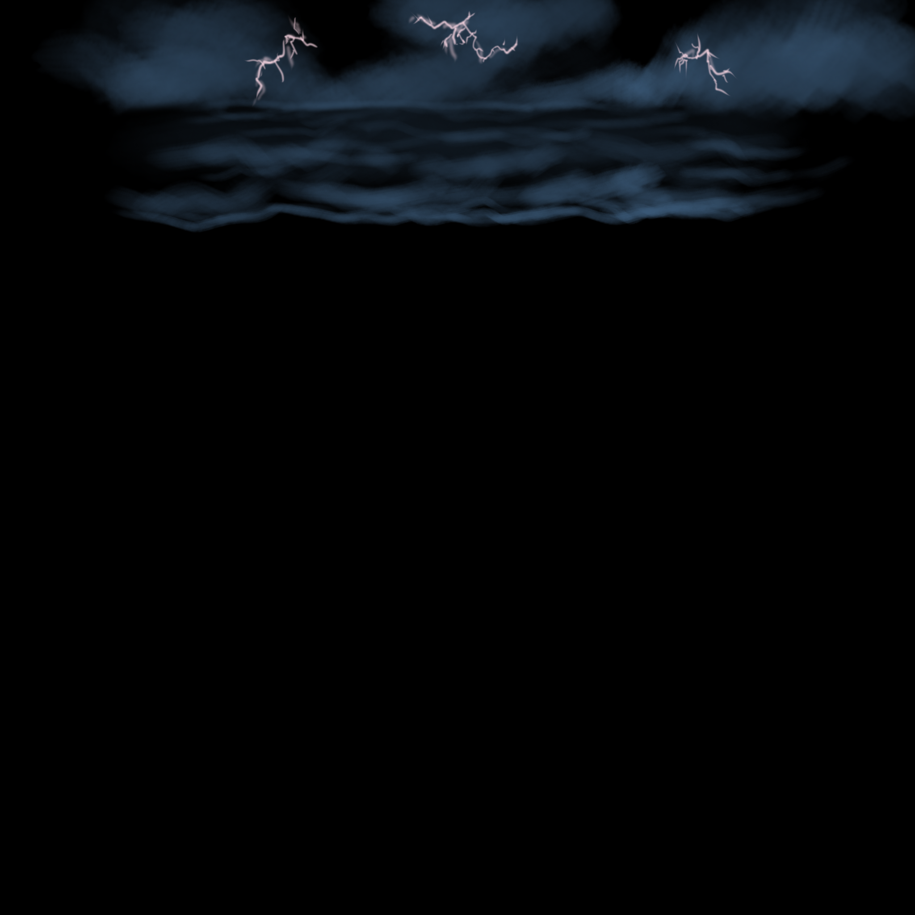
Moving Forward
Teaching the game to players via clear instructions
Further visual feedback for clarity
Further balancing for most fun
Finalise audio
AP
Notes:
Future visual feedback will be these graphics appearing in the background to show powerup use, as well as possibly particles on fish catch.
The graphics you can see on the right appear when powerups are used - storm for the fish speed and glowing jelly for the increased jellyfish.
Future balancing will be making the rubber banding as effective as possible for a fair and fun experience.

Slide 13
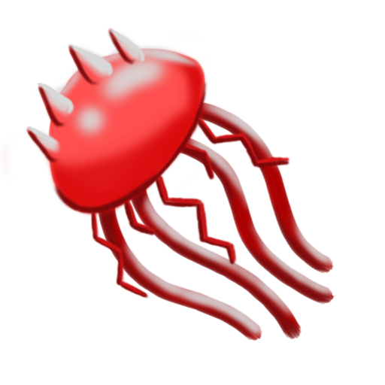
Improvements Out of Our Scope
Despite rubber-banding, the randomness of jellyfish spawning can still lead to balance problems.
Checks in code for stopping unfair situations from occuring.
E.g. no jellyfish for 10 seconds -> guarantee jellyfish.
AT
Notes:
The random nature of fish spawning can lead to unfair situations even though we try to influence it with probabilities and rubber banding. With more time, we could implement checks to ensure that a player doesn’t get an unfair number of jellyfish, too many big fish, and other random occurrences which can spoil a game. Relying on the randomiser isn’t a big problem as the game is intended to be played multiple times by the same two players so the randomness should balance out, but it would be nice to implement some hard checks if we had more time.

Slide 14
Questions?

